Slide 1
CS410: Final Project
An App on Sentimental Analysis and NLP Model Comparison
Team: LastMile
Winston Zhu

Slide 2
What Problems to Solve
I want to build a full-stack web application that has interaction logic plus NLP models behind the scene, which can help user perform basic sentiment analysis using various models.
I want to justify why I picked the models to the application and compare different model performance.
Notes:
Do not need to config, just pull and run

Slide 3

How to Install the App - Step 1
Go to https://github.com/winston86zhu/UserSentimentAnalysis
Install the software using pip, listed in the Document the Usage of Software section.

Slide 4
How to Install the App - Step 2
Launch Jupyter Notebook in the main directory
Navigate to the ./model directory and open `bayes.ipynb` and `svm.ipynb`
Run the program from top to bottom and verify if the accuracies match the numbers in README.
The SVM fitting process will take a bit long

Slide 5
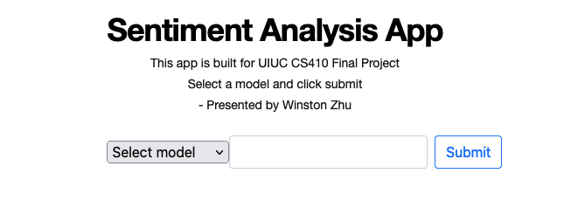
How to Install the App - Step 3
Run the main.py in terminal
Open http://127.0.0.1:8080/ and you should see this

Slide 6
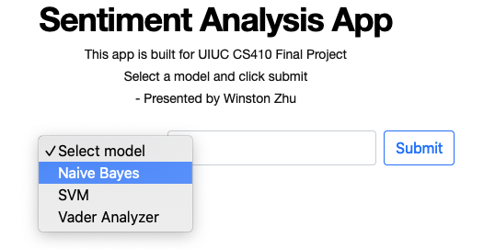
How to Install the App - Step 4
Select the Model
Enter your input text: “The weather is awesome!” (This is an example)
Submit and see result

Slide 7
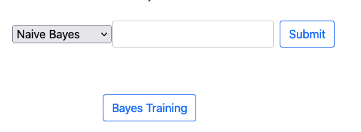
How to Install the App - Step 5
For Bayes and SVM models, I set to use the pre-trained model by default. However, I gave the option in the bayes model to reload and use the live data to train. I did not do so for SVM because SVM takes more than 2 mins to fit the training data.
If you want to do so, click the `Bayes Training` button pop up once you select Bayes Model

Slide 8
THANK YOU FOR LESSIONING
Any Question?
Winston Zhu

